Slide 1
Research Abroad Mock UI
1905074,1905076,1905085, 1905107,1905116,1905117,1605068

Slide 2
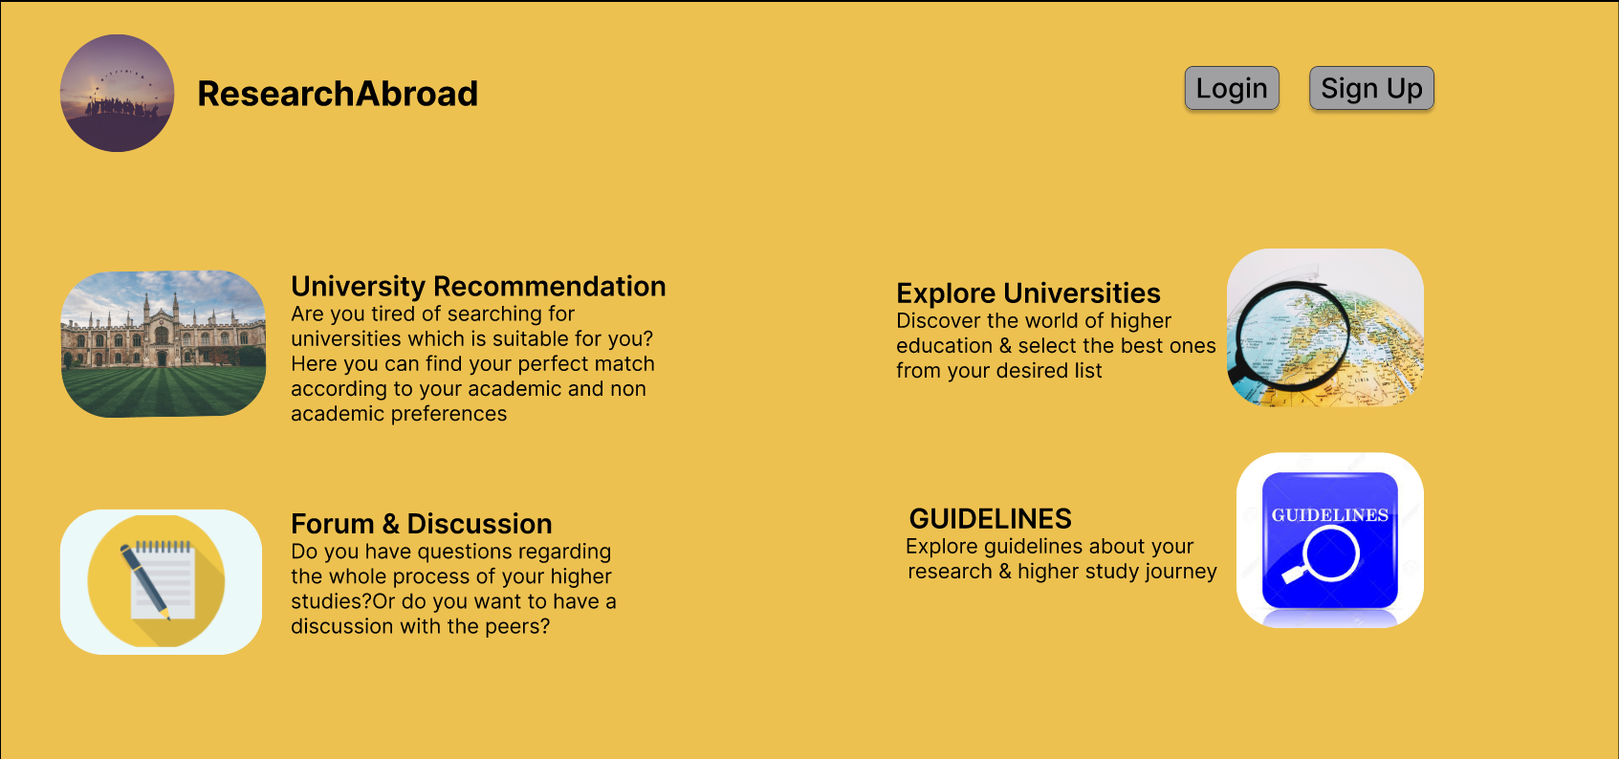
Homepage

Slide 3
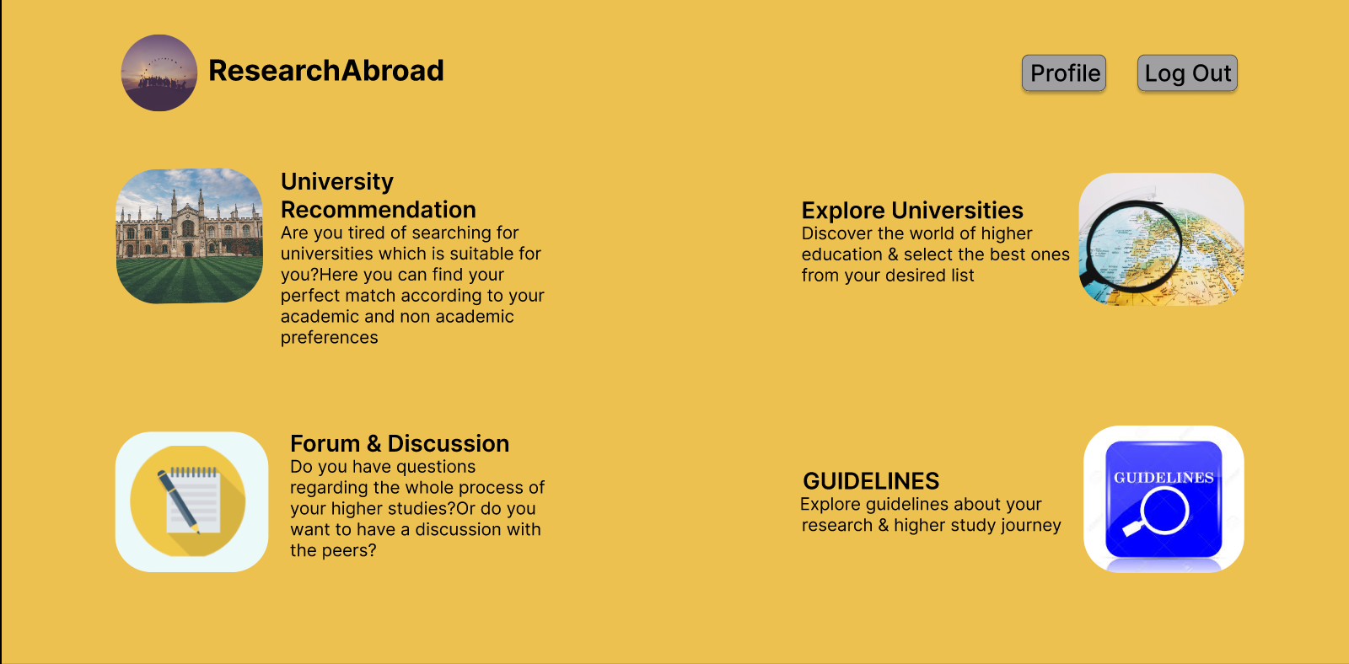
User Logged In

Slide 4
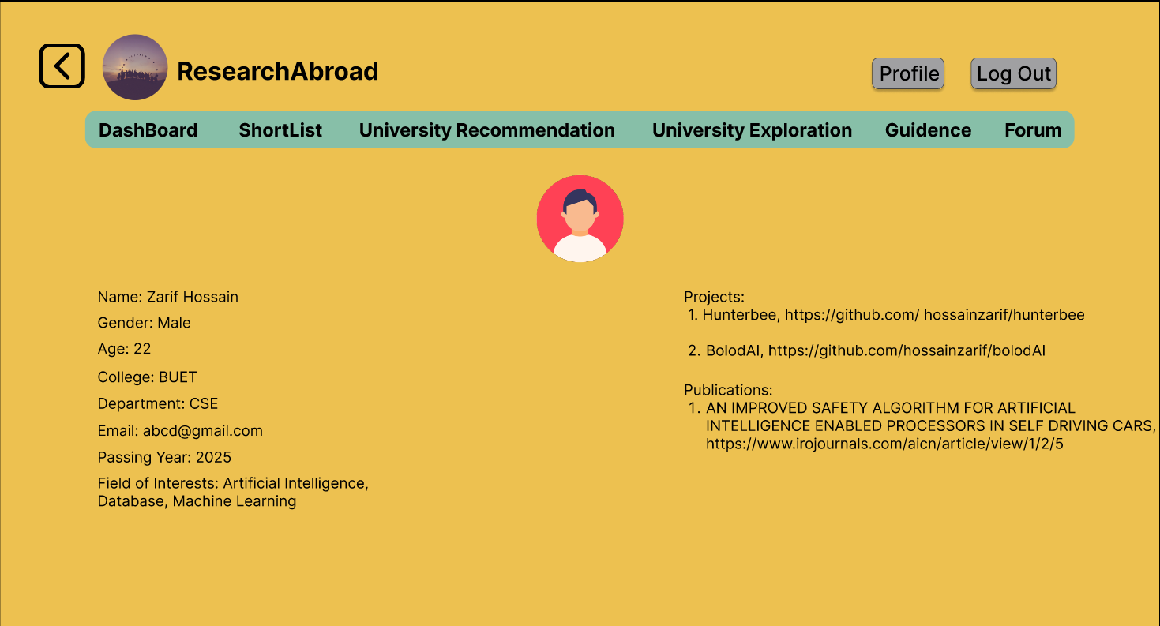
User Profile(Public)

Slide 5
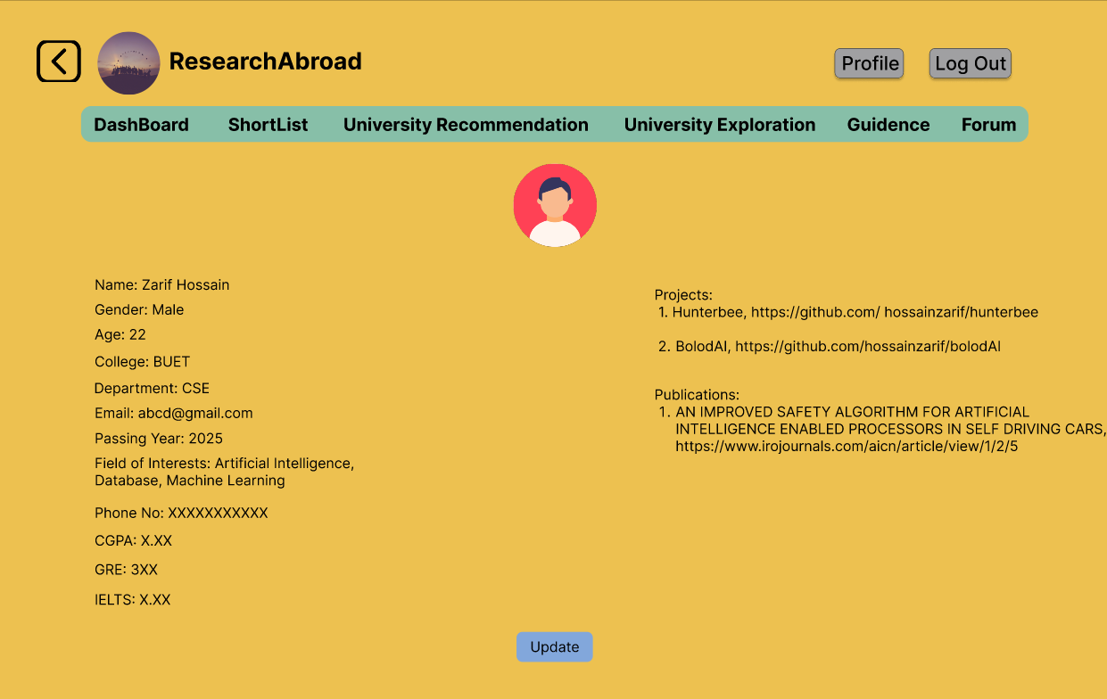
User Profile(Private)

Slide 6
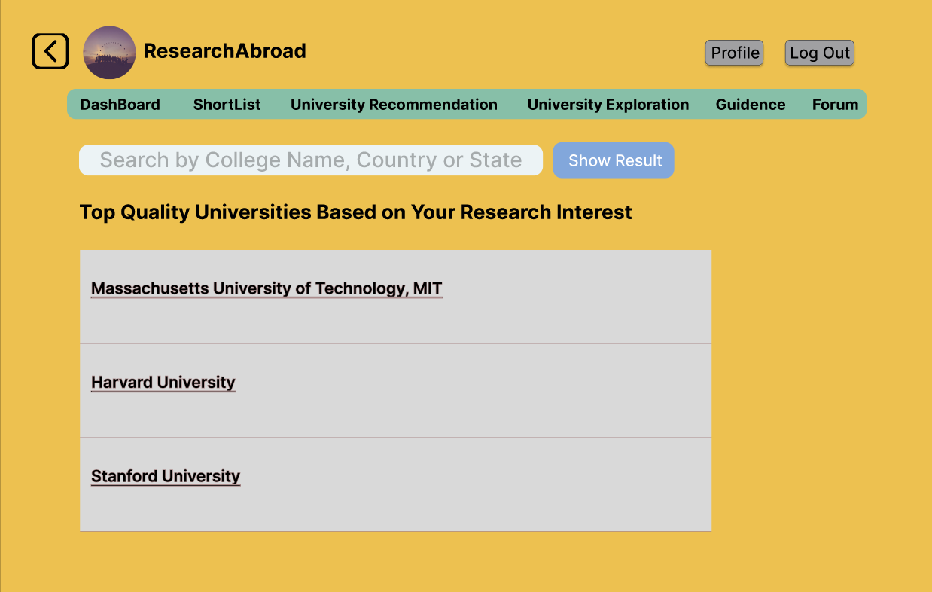
University Exploration

Slide 7
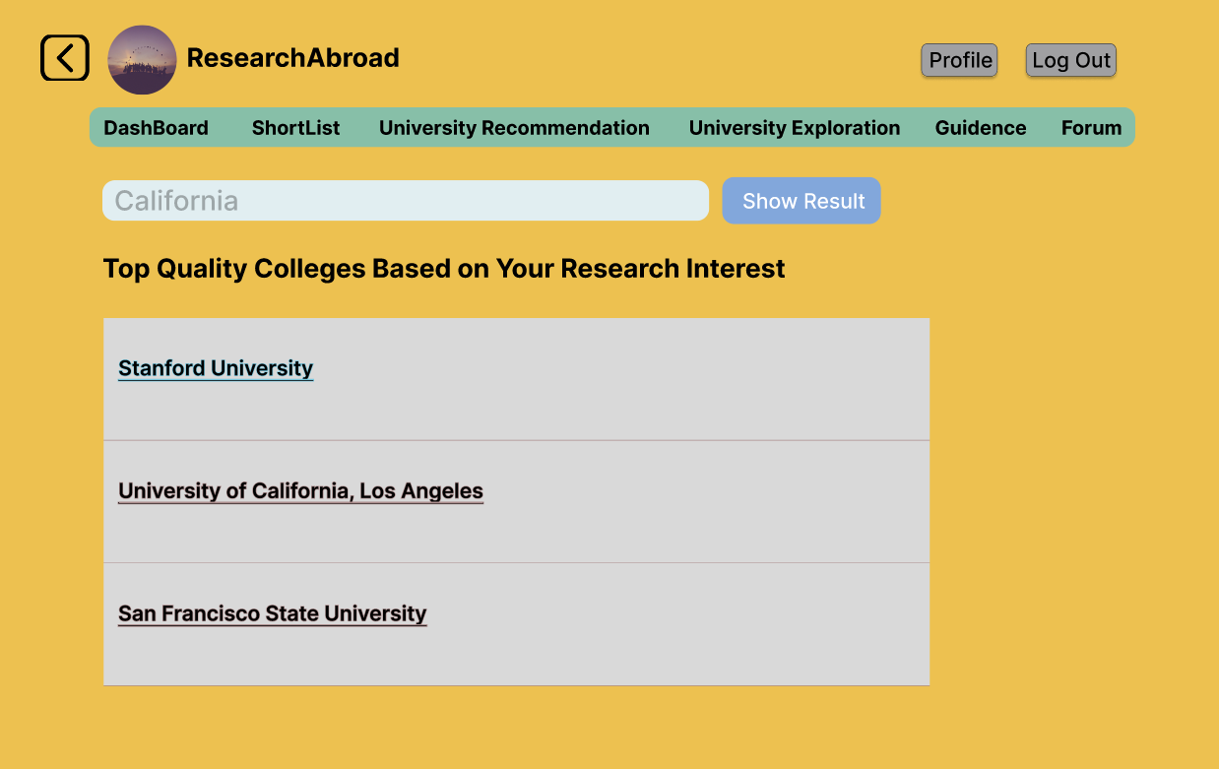
Search Results in University Exploration

Slide 8
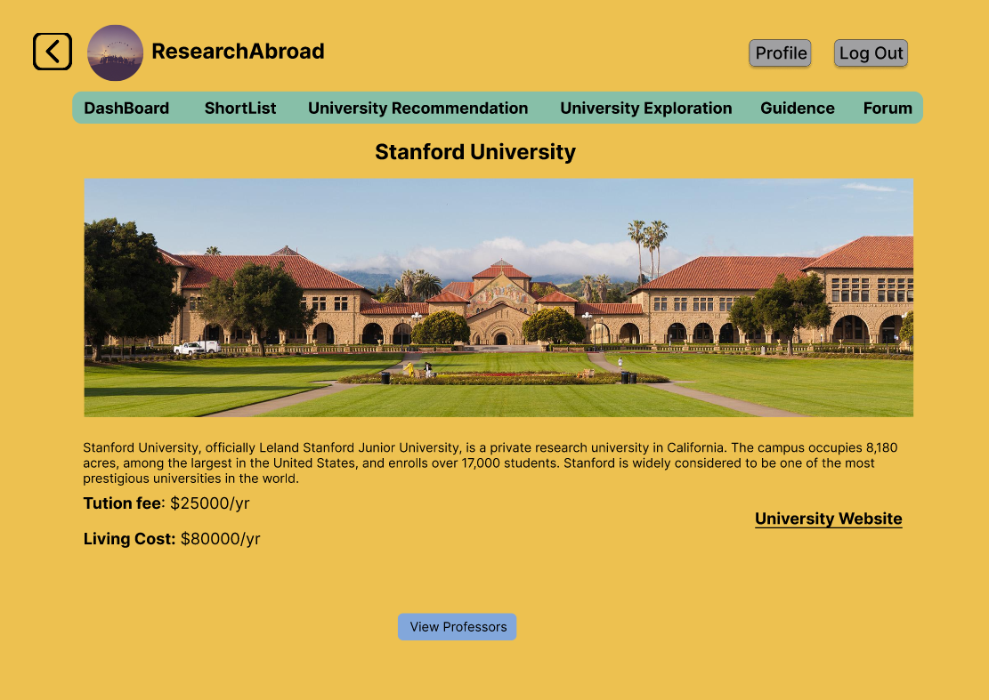
University

Slide 9
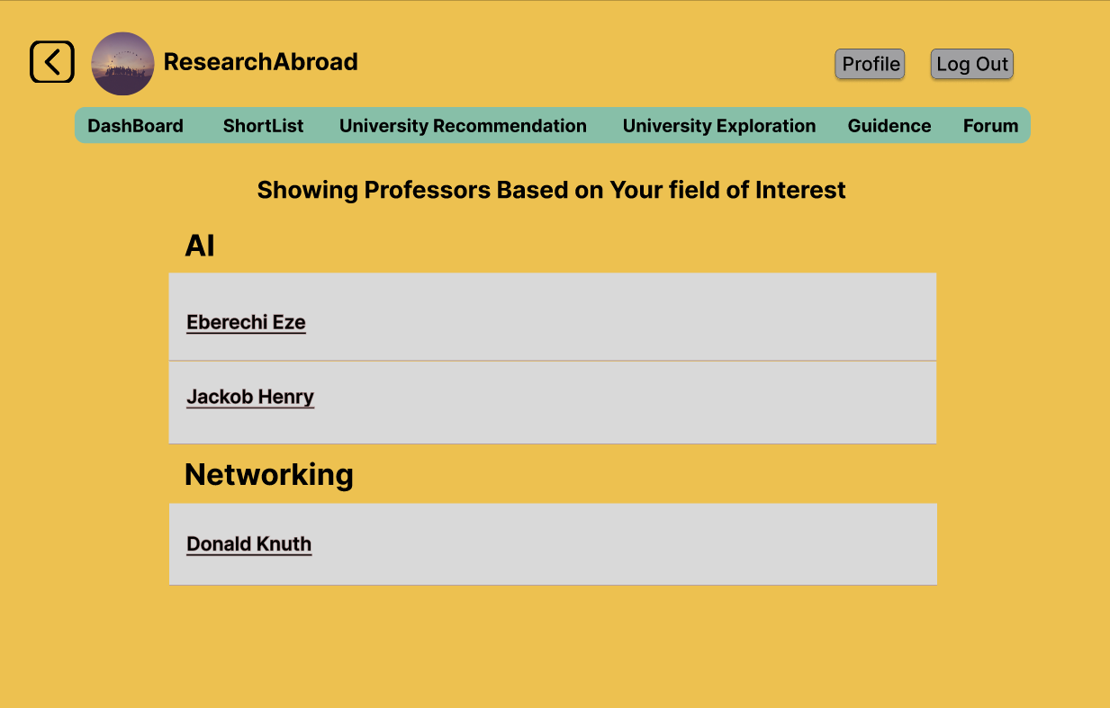
Showing Professors

Slide 10
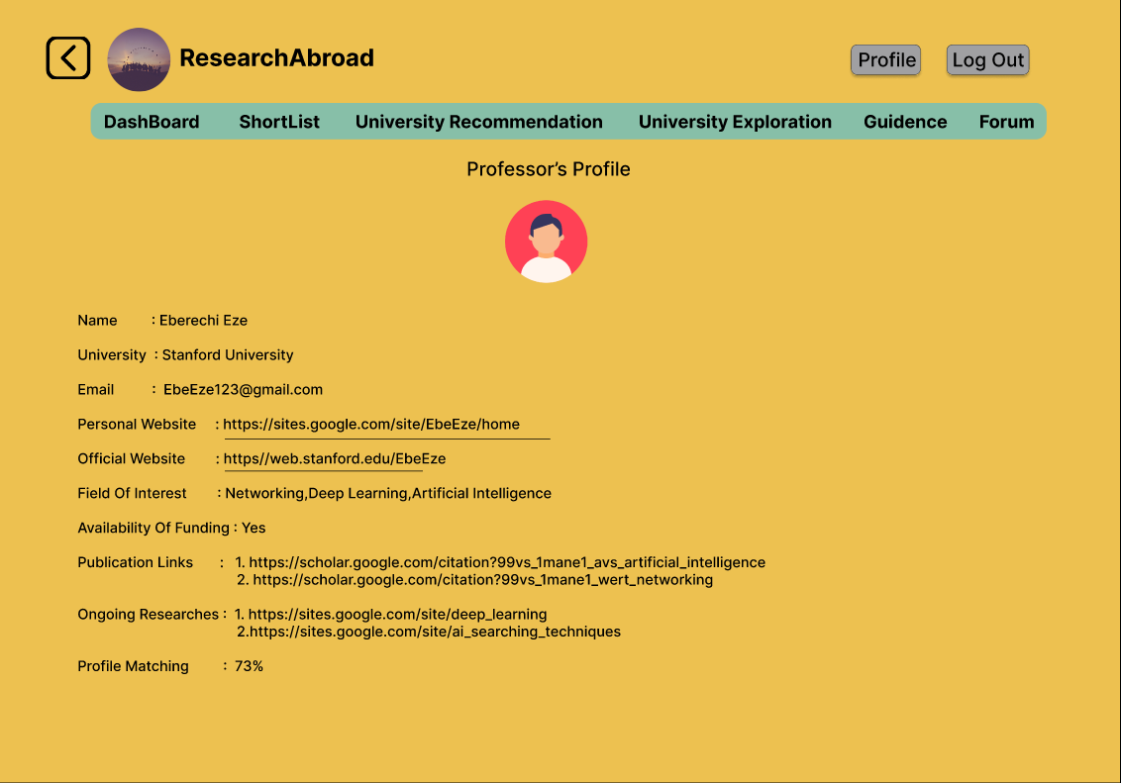
Professor’s Profile

Slide 11
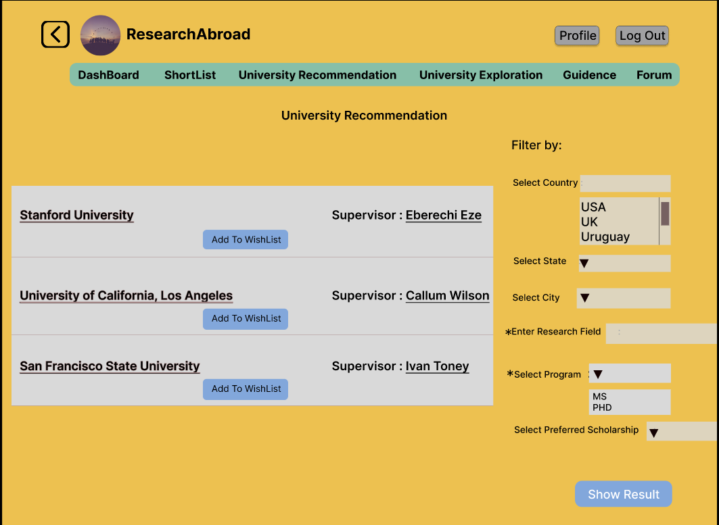
University Recommendation

Slide 12
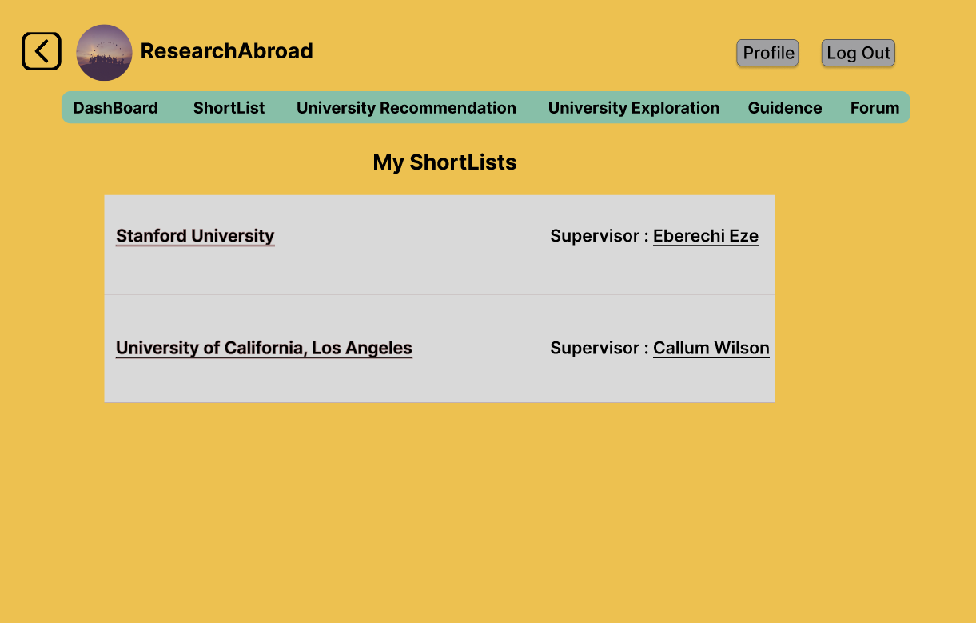
User’s Shortlist

Slide 13
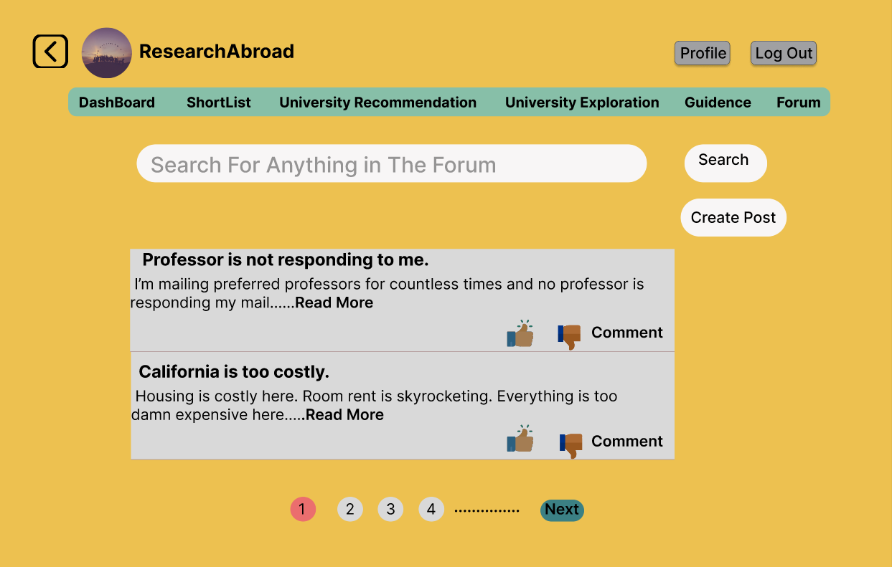
Forum

Slide 14
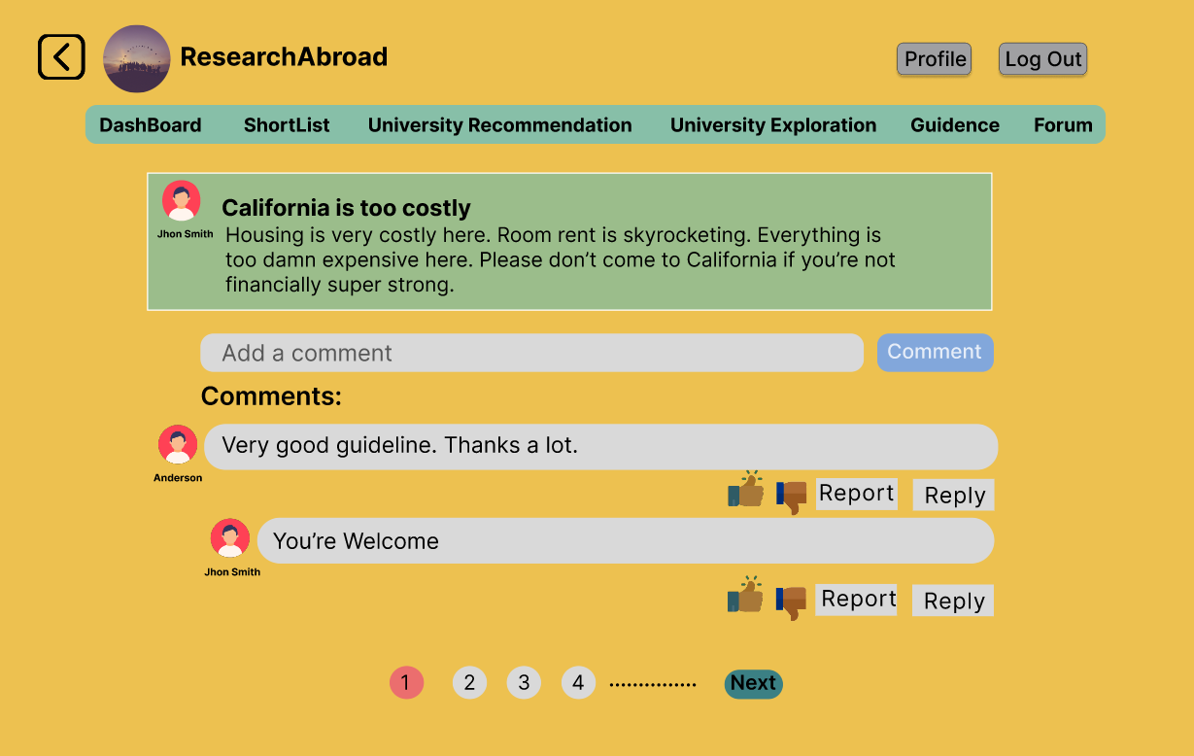
Post

Slide 15
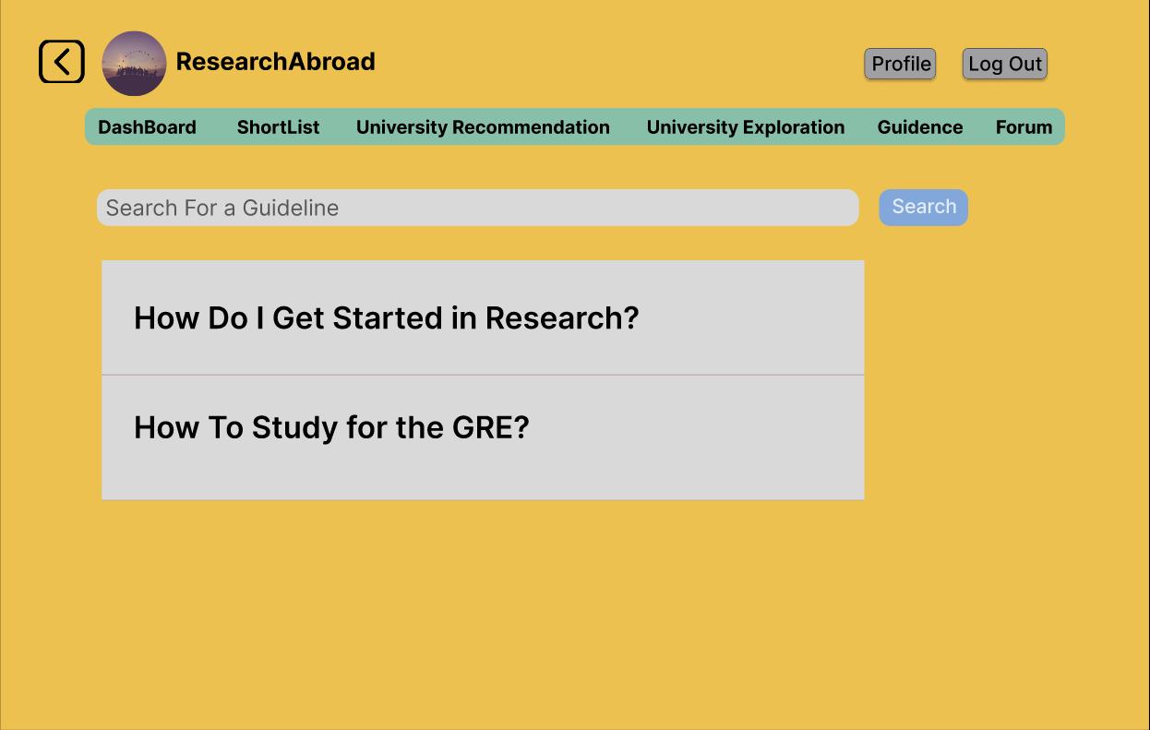
Guidance

Slide 16
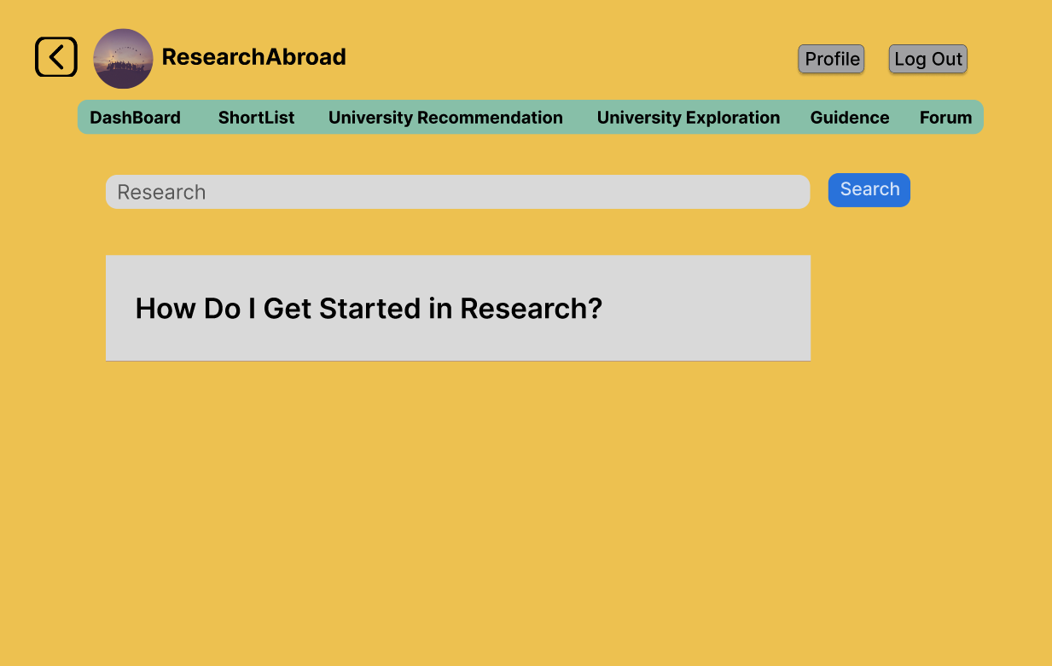
Search Results

Slide 17
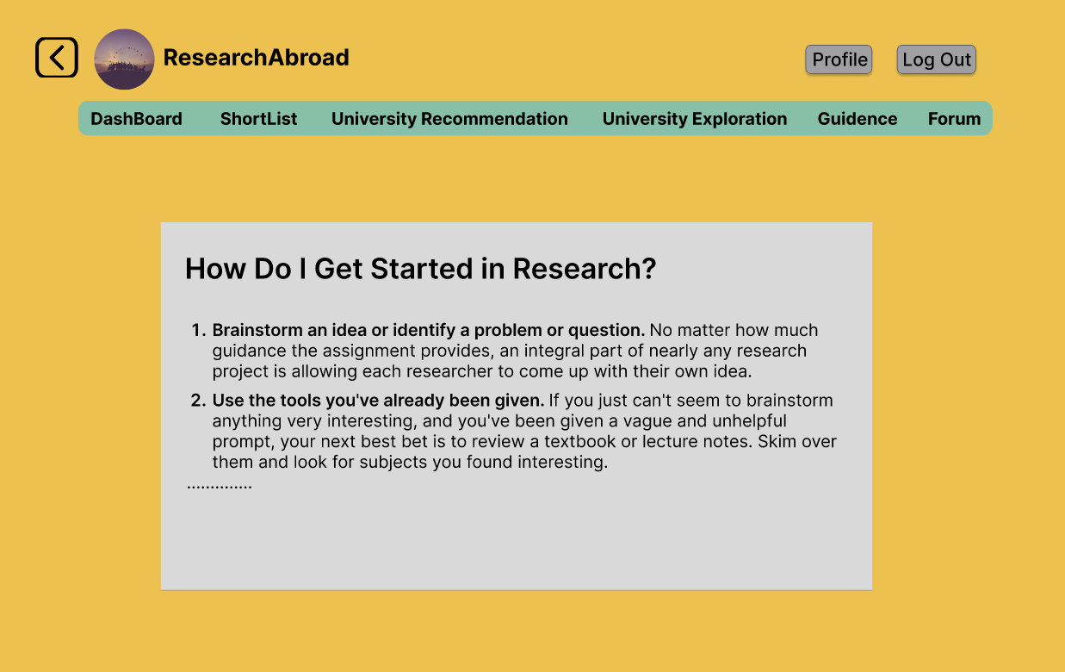
Post

Slide 18
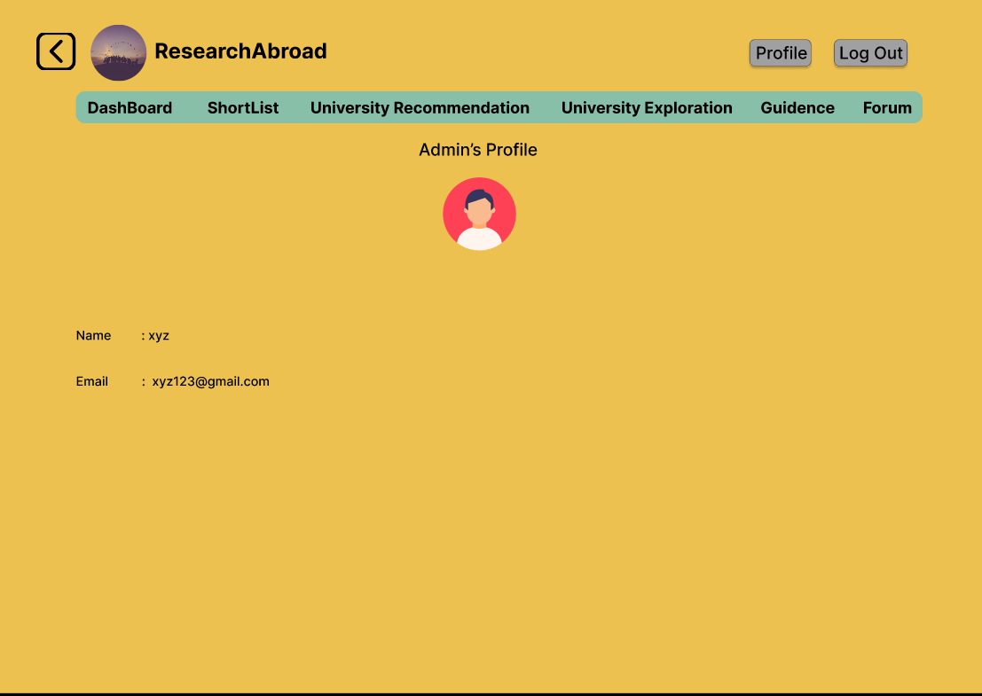
Admin’s Profile

Slide 19
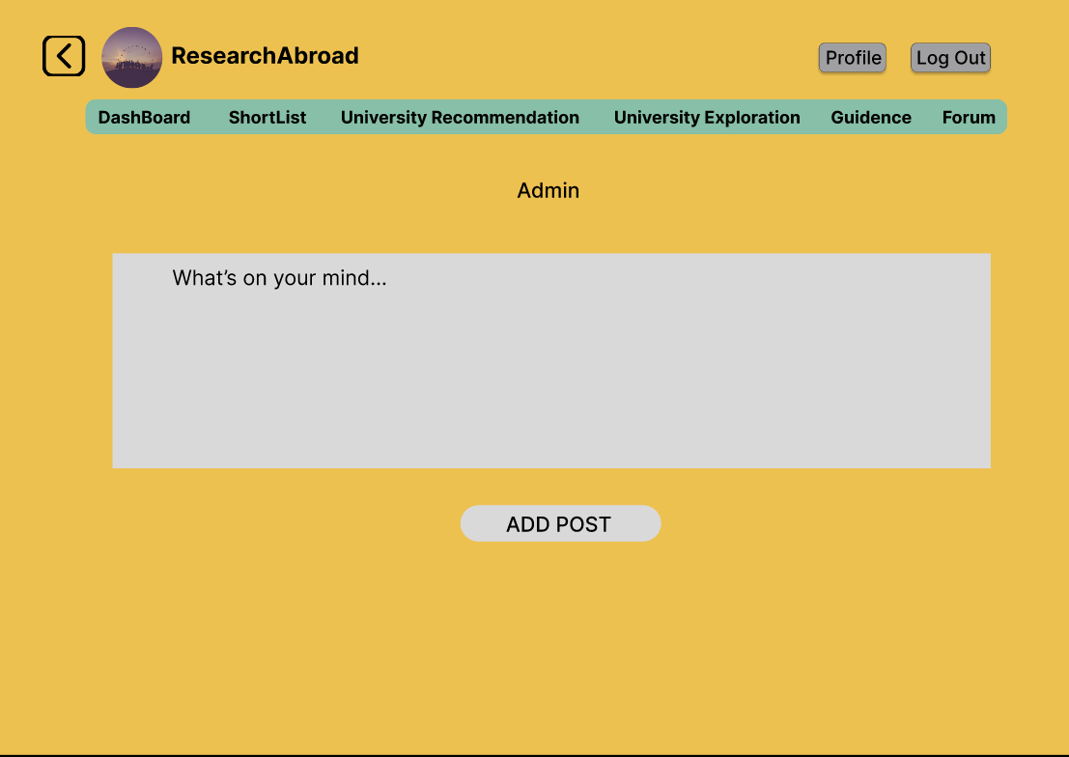
Adding Post

Slide 20
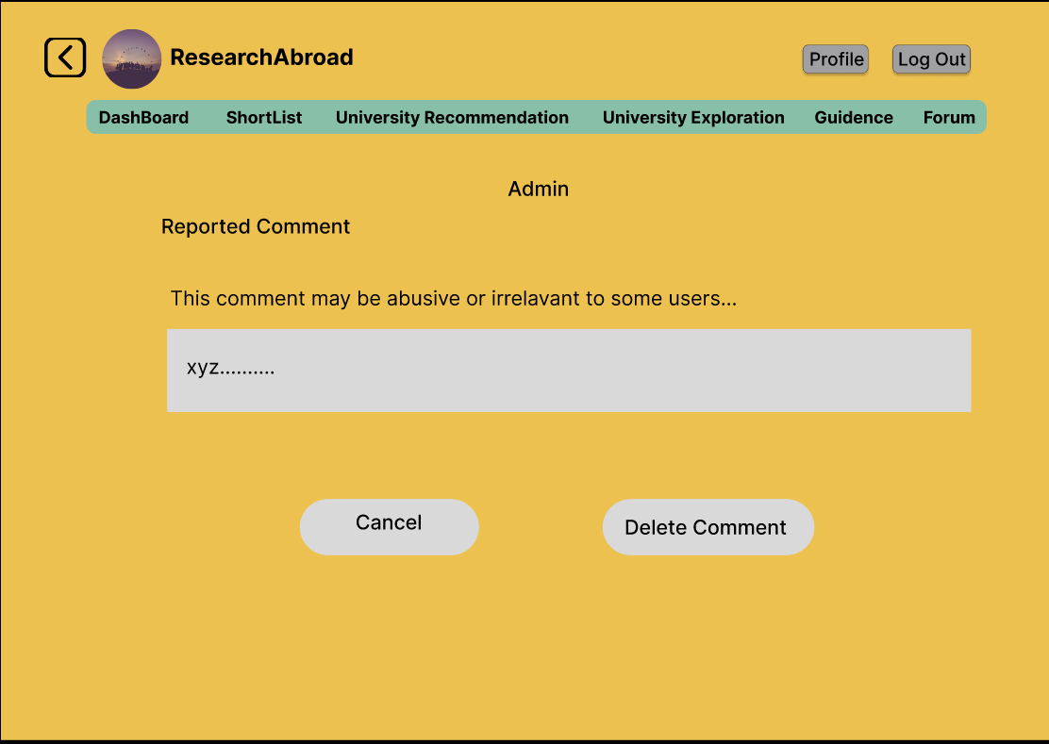
Modifications by Admin

Slide 21
Thank You

